Slide 1
Physics 101: Mechanics
D. M. Sanni

Slide 2
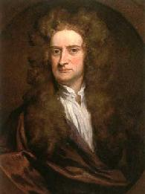
The Laws of Motion
Newton’s first law
Force
Mass
Newton’s second law
Newton’s third law
Examples
Isaac Newton’s work represents one of the greatest contributions to science ever made by an individual.
Feb. 11-15, 2013

Slide 3
Dynamics
Describes the relationship between the motion of objects in our everyday world and the forces acting on them
Language of Dynamics
  Force: The measure of interaction between two objects (pull or push). It is a vector quantity – it has a magnitude and direction
  Mass: The measure of how difficult it is to change object’s velocity (sluggishness or inertia of the object)
Feb. 11-15, 2013

Slide 4
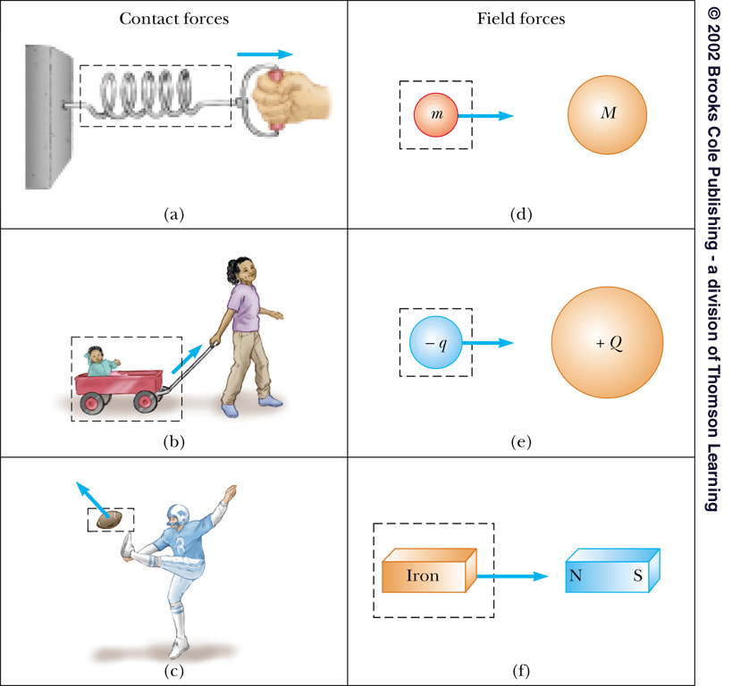
Forces
The measure of interaction between two objects (pull or push)
Vector quantity: has magnitude and direction
May be a contact force or a field force
  Contact forces result from physical contact between two objects
  Field forces act between disconnected objects
    Also called “action at a distance”
Feb. 11-15, 2013

Slide 5
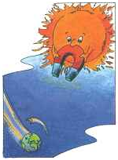


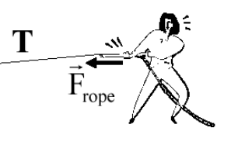
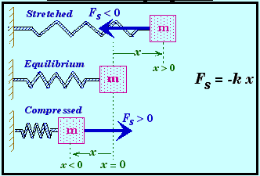
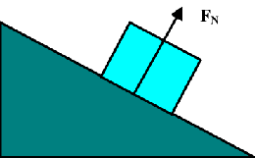
Forces
Gravitational Force
Archimedes Force
Friction Force
Tension Force
Spring Force
Normal Force
Feb. 11-15, 2013

Slide 6
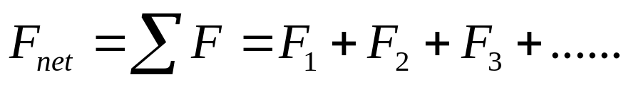
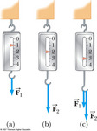
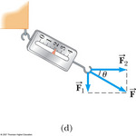
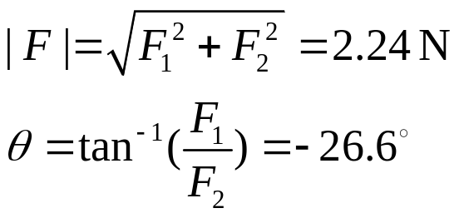
Vector Nature of Force
Vector force: has magnitude and direction
Net Force: a resultant force acting on object
You must use the rules of vector addition to obtain the net force on an object
Feb. 11-15, 2013

Slide 7
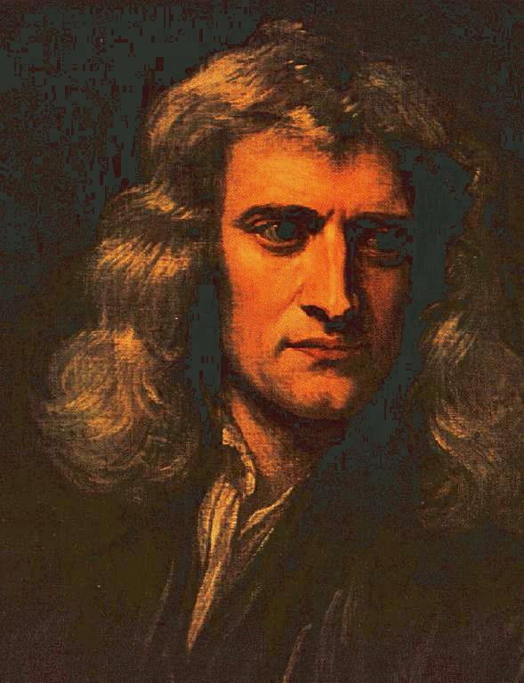
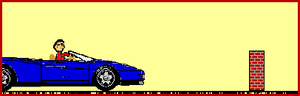
Newton’s First Law
An object at rest tends to stay at rest and an object in motion tends to stay in motion with the same speed and in the same direction unless acted upon by an unbalanced force
An object at rest remains at rest as long as no net force acts on it
An object moving with constant velocity continues to move with the same speed and in the same direction (the same velocity) as long as no net force acts on it
“Keep on doing what it is doing”
Feb. 11-15, 2013

Slide 8
Newton’s First Law
An object at rest tends to stay at rest and an object in motion tends to stay in motion with the same speed and in the same direction unless acted upon by an unbalanced force
When forces are balanced, the acceleration of the object is zero
  Object at rest: v = 0 and a = 0
  Object in motion: v ≠ 0 and a = 0
The net force is defined as the vector sum of all the external forces exerted on the object. If the net force is zero, forces are balanced. When forces are balances, the object can be stationary, or move with constant velocity.
Feb. 11-15, 2013

Slide 9
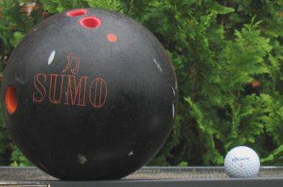
Mass and Inertia
Every object continues in its state of rest, or uniform motion in a straight line, unless it is compelled to change that state by unbalanced forces impressed upon it
Inertia is a property of objects
to resist changes is motion!
Mass is a measure of the
amount of inertia.
Mass is a measure of the resistance of an object to changes in its velocity
Mass is an inherent property of an object
Scalar quantity and SI unit: kg
Feb. 11-15, 2013

Slide 10
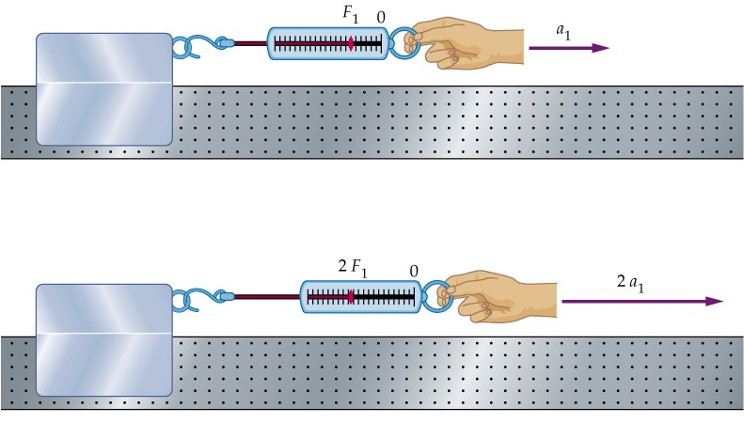
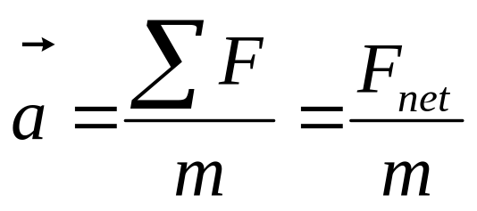
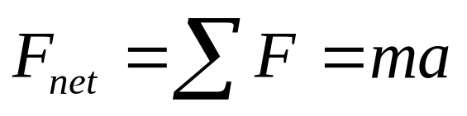
Newton’s Second Law
The acceleration of an object is directly proportional to the net force acting on it and inversely proportional to its mass
Feb. 11-15, 2013
Notes:
Newton’s first law explains what happens to an object when no forces act on it: it either remains at rest or moves in a straight line with constant speed. So, what will happen to an object if the net force is not zero? Newton’s 2nd law answers this question.
The force will change the motion of the object and create an acceleration. Newton’s 2nd law states the acceleration of an object is directly proportional to the net force acting on it and inversely proportional to its mass.
Let’s take a look of this experiment: imagine pull a block of mass across a frictionless horizontal surface. When we exert F1 on the block, it moves with an acceleration of a1. If we apply a force twice as great on the same block, the acceleration doubles. If we increase force to 3F1, the acceleration triples.

Slide 11
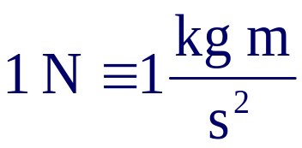
Units of Force
Newton’s second law:
SI unit of force is a Newton (N)
US Customary unit of force is a pound (lb)
  1 N = 0.225 lb
  Weight, also measured in lbs. is a force (mass x acceleration). What is the acceleration in that case?
Feb. 11-15, 2013

Slide 12
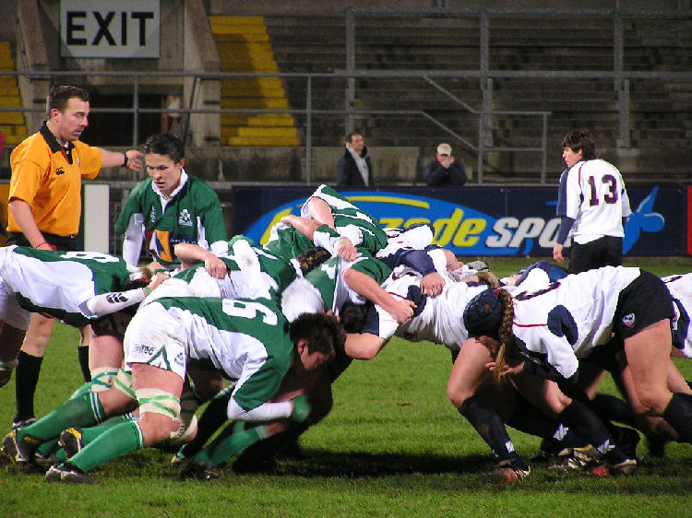
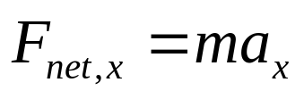
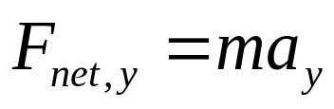
More about Newton’s 2nd Law
You must be certain about which body we are applying it to
F_{net} must be the vector sum of all the forces that act on that body
Only forces that act on that body are to be included in the vector sum
Net force component along an
axis gives rise to the acceleration
along that same axis
Feb. 11-15, 2013

Slide 13
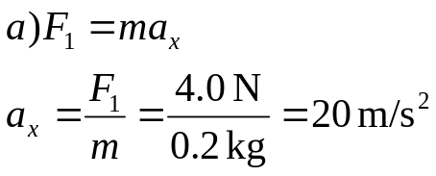
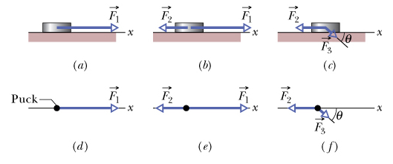
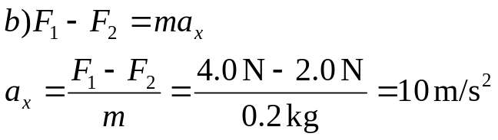
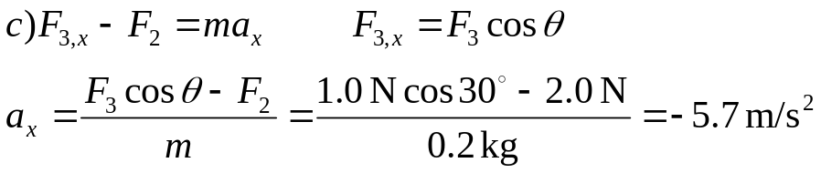
Sample Problem
One or two forces act on a puck that moves over frictionless ice along an x axis, in one-dimensional motion. The puck's mass is m = 0.20 kg. Forces F₁ and F₂ and are directed along the x axis and have magnitudes F₁ = 4.0 N and F₂ = 2.0 N. Force F₃ is directed at angle θ = 30° and has magnitude F₃ = 1.0 N. In each situation, what is the acceleration of the puck?
Feb. 11-15, 2013

Slide 14
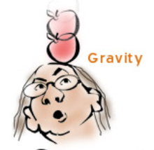
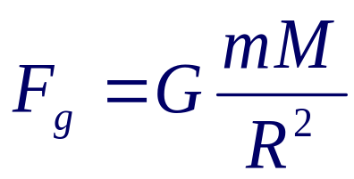
Gravitational Force
Gravitational force is a vector
Expressed by Newton’s Law of Universal Gravitation:
  G – gravitational constant
  M – mass of the Earth
  m – mass of an object
  R – radius of the Earth
Direction: pointing downward
Feb. 11-15, 2013

Slide 15

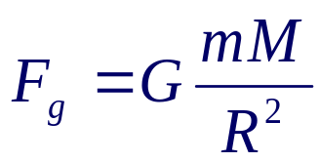
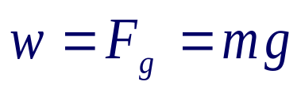
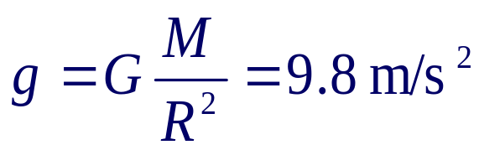
Weight
The magnitude of the gravitational force acting on an object of mass m near the Earth’s surface is called the weight w of the object: w = mg
g can also be found from the Law of Universal Gravitation
Weight has a unit of N
Weight depends upon location
R = 6,400 km
Feb. 11-15, 2013

Slide 16
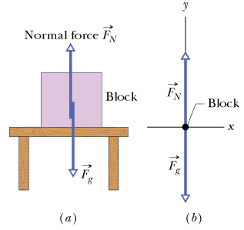

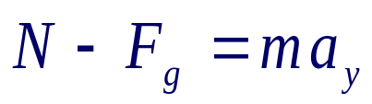
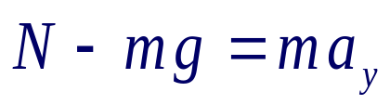

Normal Force
Force from a solid surface which keeps object from falling through
Direction: always perpendicular to the surface
Magnitude: depends on situation
Feb. 11-15, 2013

Slide 17
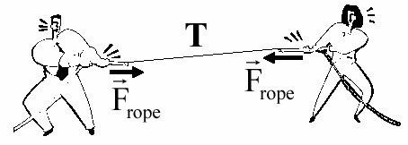

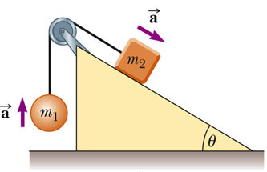
Tension Force: T
A taut rope exerts forces on whatever holds its ends
Direction: always along the cord (rope, cable, string ……) and away from the object
Magnitude: depend on situation
T1
T1 = T = T2
T2
Feb. 11-15, 2013
Notes:
The force the rope exerts is away from the object and parallel to the rope
When a rope attached to an object is pulling it, the magnitude of that force is the tension in the rope

Slide 18
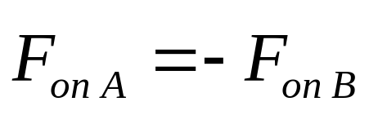
Newton’s Third Law
If object 1 and object 2 interact, the force exerted by object 1 on object 2 is equal in magnitude but opposite in direction to the force exerted by object 2 on object 1
  Equivalent to saying a single isolated force cannot exist
Feb. 11-15, 2013

Slide 19
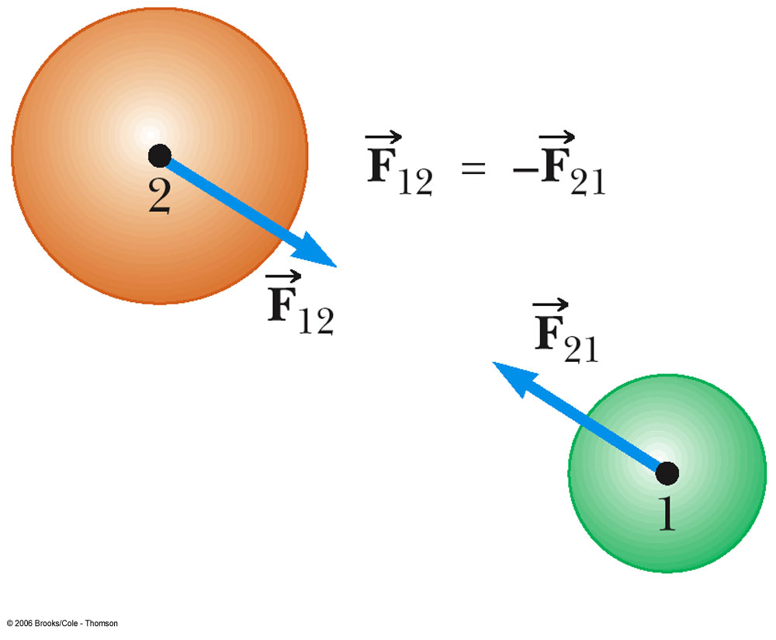
Newton’s Third Law cont.
F₁₂ may be called the action force and F₂₁ the reaction force
  Actually, either force can be the action or the reaction force
The action and reaction forces act on different objects
Feb. 11-15, 2013

Slide 20
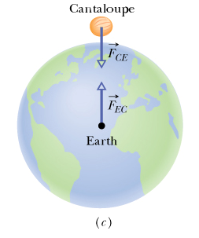
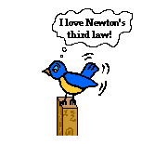
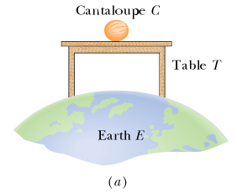

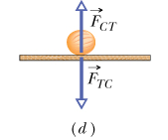
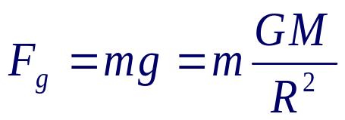

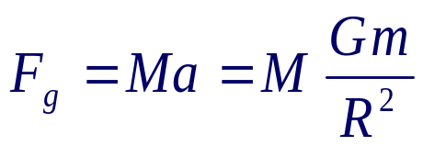
Some Action-Reaction Pairs
Feb. 11-15, 2013

Slide 21
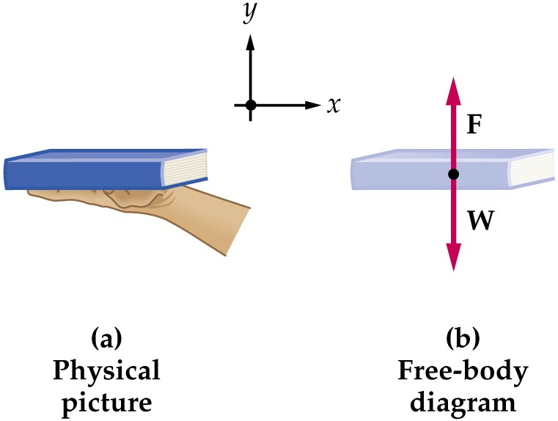
Free Body Diagram
The most important step in solving problems involving Newton’s Laws is to draw the free body diagram
Be sure to include only the forces acting on the object of interest
Include any field forces acting on the object
Do not assume the normal force equals the weight
F _{hand on book}
F _{Earth on book}
Feb. 11-15, 2013
Notes:
So far, we have discussed Newton’s laws and analyzed several particular forces. We can start to work out some problems using Newton’s laws. The most important step in solving problems involving Newton’s Laws is to draw the free body diagram. The free body diagram can simplifies the problem. Free-body diagrams are diagrams used to show the relative magnitude and direction of all forces acting upon an object in a given situation. The size of the arrow in a free-body diagram is reflects the magnitude of the force. The direction of the arrow shows the direction which the force is acting. Each force arrow in the diagram is labeled to indicate the exact type of force.
Be sure to include only the forces acting on the object of interest. Include any field forces acting on the object.

Slide 22
Hints for Problem-Solving
Read the problem carefully at least once
Draw a picture of the system, identify the object of primary interest, and indicate forces with arrows
Label each force in the picture in a way that will bring to mind what physical quantity the label stands for (e.g., T for tension)
Draw a free-body diagram of the object of interest, based on the labeled picture. If additional objects are involved, draw separate free-body diagram for them
Choose a convenient coordinate system for each object
Apply Newton’s second law. The x- and y-components of Newton second law should be taken from the vector equation and written individually. This often results in two equations and two unknowns
Solve for the desired unknown quantity, and substitute the numbers
Feb. 11-15, 2013

Slide 23

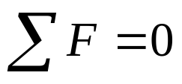
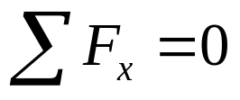
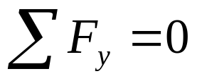
Objects in Equilibrium
Objects that are either at rest or moving with constant velocity are said to be in equilibrium
Acceleration of an object can be modeled as zero:
Mathematically, the net force acting on the object is zero
Equivalent to the set of component equations given by
Feb. 11-15, 2013

Slide 24
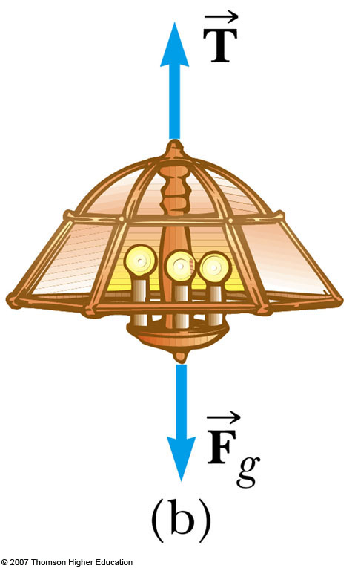
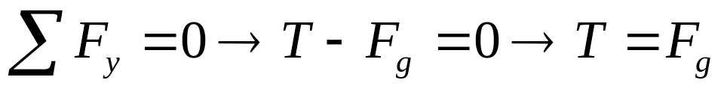
Equilibrium, Example 1
A lamp is suspended from a chain of negligible mass
The forces acting on the lamp are
  the downward force of gravity
  the upward tension in the chain
Applying equilibrium gives
Feb. 11-15, 2013

Slide 25
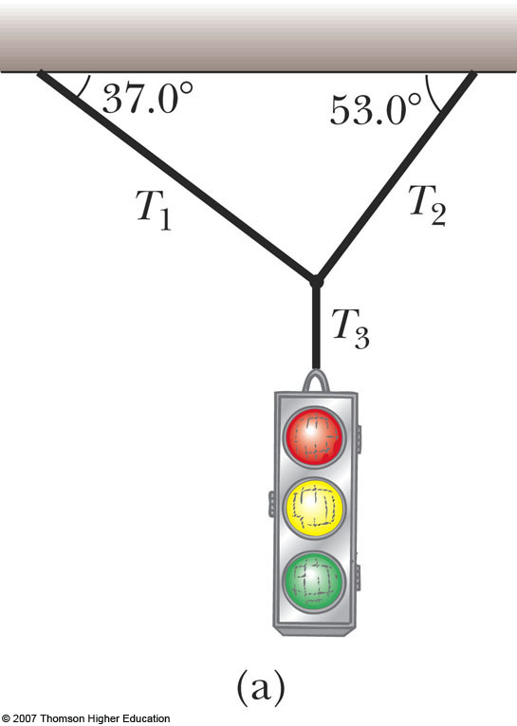
Equilibrium, Example 2
A traffic light weighing 100 N hangs from a vertical cable tied to two other cables that are fastened to a support. The upper cables make angles of 37° and 53° with the horizontal. Find the tension in each of the three cables.
Conceptualize the traffic light
  Assume cables don’t break
  Nothing is moving
Categorize as an equilibrium problem
  No movement, so acceleration is zero
  Model as an object in equilibrium
Feb. 11-15, 2013

Slide 26
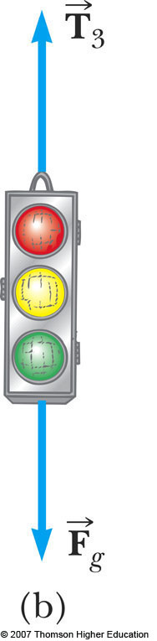



Equilibrium, Example 2
Need 2 free-body diagrams
  Apply equilibrium equation to light
  Apply equilibrium equations to knot
Feb. 11-15, 2013
Notes:
Analyze, cont.
Find T₃ from applying equilibrium in the y-direction to the light
Find T₁ and T₂ from applying equilibrium in the x- and y-directions to the knot
Finalize
Think about different situations and see if the results are reasonable

Slide 27



Accelerating Objects
If an object that can be modeled as a particle experiences an acceleration, there must be a nonzero net force acting on it
Draw a free-body diagram
Apply Newton’s Second Law in component form
Feb. 11-15, 2013

Slide 28








Accelerating Objects, Example 1
A man weighs himself with a scale in an elevator. While the elevator is at rest, he measures a weight of 800 N.
  What weight does the scale read if the elevator accelerates upward at 2.0 m/s²? a = 2.0 m/s²
  What weight does the scale read if the elevator accelerates downward at 2.0 m/s²? a = - 2.0 m/s²
Upward:
Downward:
N
N
mg
mg
Feb. 11-15, 2013

